Slide 1

How to Make
Statutory License Royalty Payments Using Pay.gov
A Tutorial

Slide 2
Statutory License Royalty Payments
Using Pay.gov (Circular 74c)
Before you begin > Complete Agency Form > Enter Payment Information > Review & Submit > Confirmation > Contact
Under the copyright statutory licenses, cable systems and satellite carriers must pay royalty and filing fees using electronic funds transfer (EFT).
Under the copyright statutory licenses, digital audio recording technology (DART) manufacturers and importers must pay a royalty fee using electronic funds transfer (EFT).

Slide 3
Statutory License Royalty Payments
Using Pay.gov (Circular 74c)
Before you begin > Complete Agency Form > Enter Payment Information > Review & Submit > Confirmation > Contact
The EFT process benefits the remitter and the Copyright Office as the agency responsible for collecting and distributing royalty fees.
EFTs can be transmitted either as Automated Clearing House (ACH) credits or as Fedwire (“Wire”) transactions, depending on how a transfer is arranged through your financial institution. Alternatively, EFTs can be transmitted as ACH debits using the United States Treasury Department’s web-based remittance system, Pay.gov.
This tutorial complements Circular 74c, which is about Pay.gov. For other payment options, see Circular 74a, How to Make Statutory License Royalty Payments by Wire, or Circular 74b, How to Make Statutory License Royalty Payments by ACH Credit.

Slide 4
Steps to Make EFT Payments
Using Pay.gov
Before you begin > Complete Agency Form > Enter Payment Information > Review & Submit > Confirmation > Contact
Contact your financial institution to determine if your account will accept an ACH debit.
For the best experience, please use Internet Explorer 9 or higher, Chrome, Firefox, or Safari.
Set your browser URL to http://www.copyright.gov/licensing/royalty.
If you are a registered user, go directly to the Pay.gov website, https://pay.gov/paygov.
NOTE: If you do not yet have a user name and password, call a Licensing Division financial specialist at (202) 707-8150 or email licensing@copyright.gov.
For forgotten passwords contact:
  800-624-1373 (Toll free, Option #2)
  216-579-2112 (Option #2)
  pay.gov.clev@clev.frb.org 7:00 AM - 7:00 PM Monday – Friday (Eastern Time)
.

Slide 5
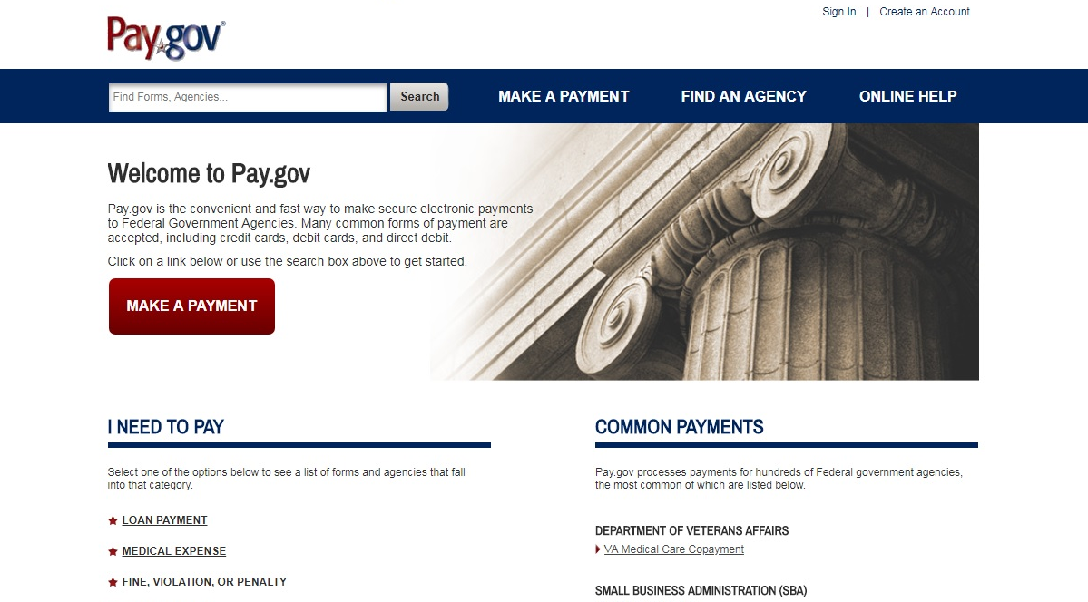
Home Page
Before you begin > Complete Agency Form > Enter Payment Information > Review & Submit > Confirmation > Contact
Click Sign In.

Slide 6
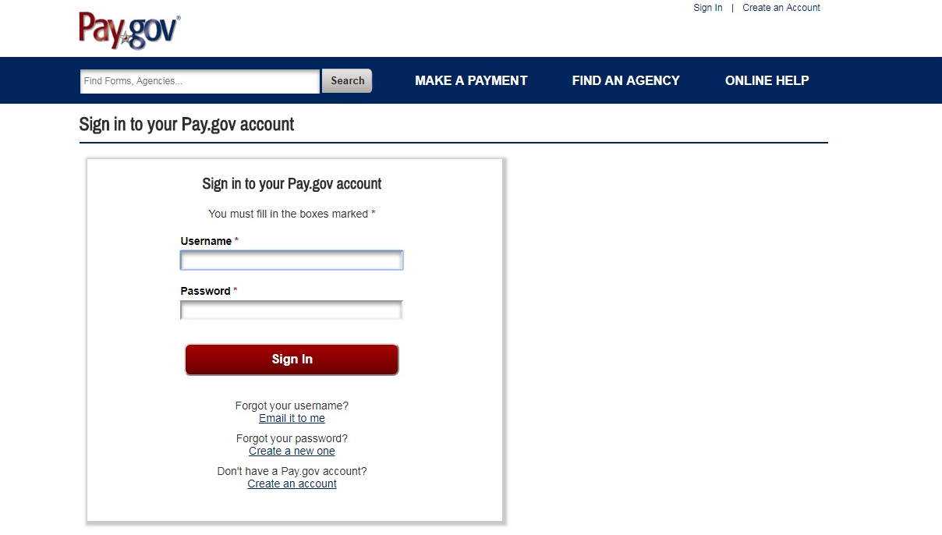
Sign In
Before you begin > Complete Agency Form > Enter Payment Information > Review & Submit > Confirmation > Contact
Enter your User Name
and Password.
Click on the
Sign In button.

Slide 7
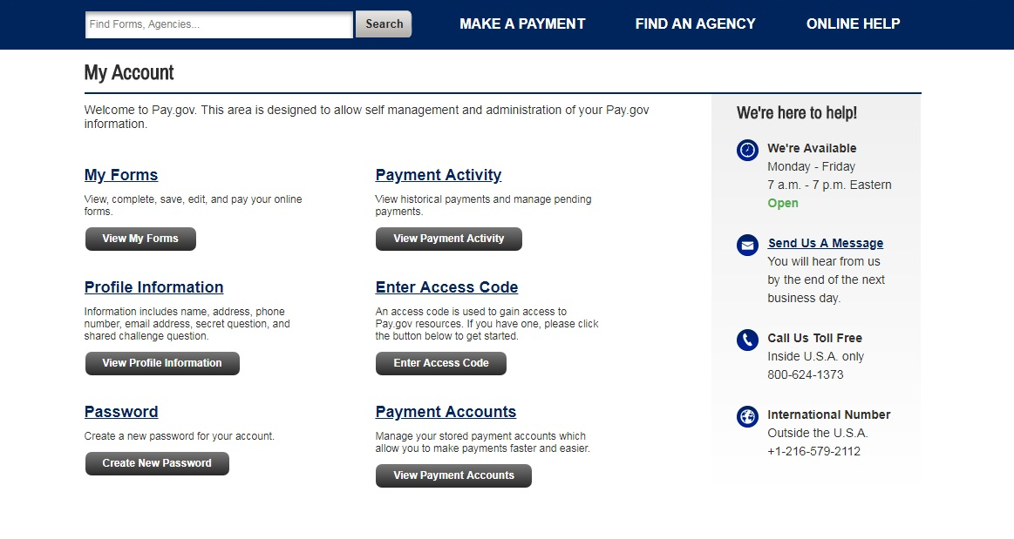
My Account
Before you begin > Complete Agency Form > Enter Payment Information > Review & Submit > Confirmation > Contact
Click My Forms.

Slide 8
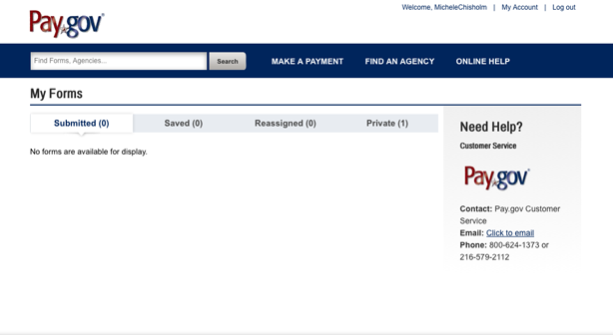
Private Forms List
Before you begin > Complete Agency Form > Enter Payment Information > Review & Submit > Confirmation > Contact
Click Private.

Slide 9
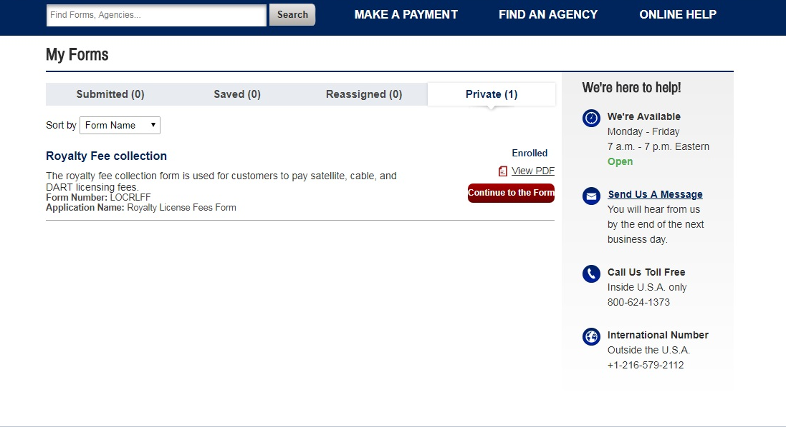
Private Forms List
Before you begin > Complete Agency Form > Enter Payment Information > Review & Submit > Confirmation > Contact
Click Continue to the Form button.

Slide 10
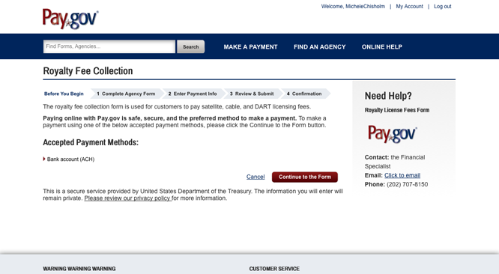
Private Forms Lists
Before you begin > Complete Agency Form > Enter Payment Information > Review & Submit > Confirmation > Contact
Click Continue to the Form button again.

Slide 11
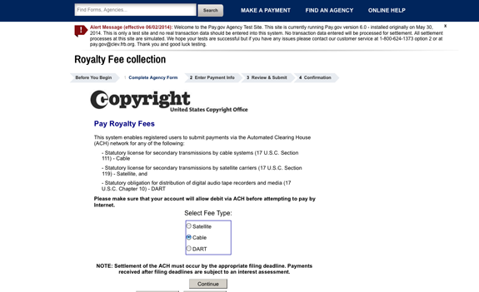
Fee Type
Before you begin > Complete Agency Form > Enter Payment Information > Review & Submit > Confirmation > Contact
Select the type of
royalty fee payment
to be made.
Then click Continue.

Slide 12
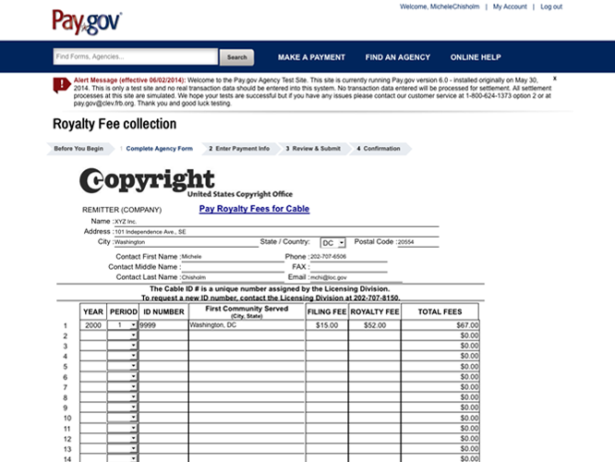
Pay Royalty and Filing Fees
Before you begin > Complete Agency Form > Enter Payment Information > Review & Submit > Confirmation > Contact
Enter name of your
company and other
requested information
Filing Period
First Community Served
(cable only)
Royalty and
Interest (if applicable)
Identification Number
(see next slide)
Filing Fee
(cable and satellite only)

Slide 13
Identification Number
Before you begin > Complete Agency Form > Enter Payment Information > Review & Submit > Confirmation > Contact
To proceed, a system identification number is required—a
unique number assigned by the Licensing Division.
If you are filing your statements of account electronically, add
an E to the end of your ID# (e.g., 12345E)
If you are a first-time filer, you may enter 00000 or 99999, and
upon receipt of the statement, the Division will assign a system
identification number.
If you do not know the identification number, contact the
Licensing Division at (202) 707-8150 or licensing@copyright.gov.

Slide 14
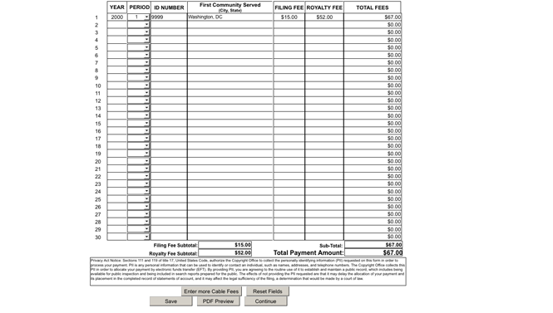
Pay Royalty and Filing Fees
Before you begin > Complete Agency Form > Enter Payment Information > Review & Submit > Confirmation > Contact
Important: Make sure to
save or print before continuing.
The screen allows you to enter
additional fees, reset fields, save,
and download a PDF preview.
Save or print this page,
then click Continue.

Slide 15
Cable and Satellite Filing Fees
Before you begin > Complete Agency Form > Enter Payment Information > Review & Submit > Confirmation > Contact
Effective January 1, 2014, pursuant to the Satellite Television Extension and Localism Act of 2010 (STELA), which granted authority to the Copyright Office to establish fees for the filing of statements of account (SOAs) under the section 111, 119, and 122 statutory licenses, the Office now assesses filing fees for ALL SOAs for current, past, and future accounting periods. Licensing Division filing fees:
Cable SA-1: $15 Cable SA-3: $725
Cable SA-2: $20 Satellite SA: $725
For details, see the Federal Register, November 29, 2013 (78 FR 71498). Please be advised that the filing fee is deducted before the royalty payment is credited; thus the omission of the appropriate filing fee will result in an underpayment of royalty fees. Please remit the royalty fee and filing fee in one EFT payment.

Slide 16
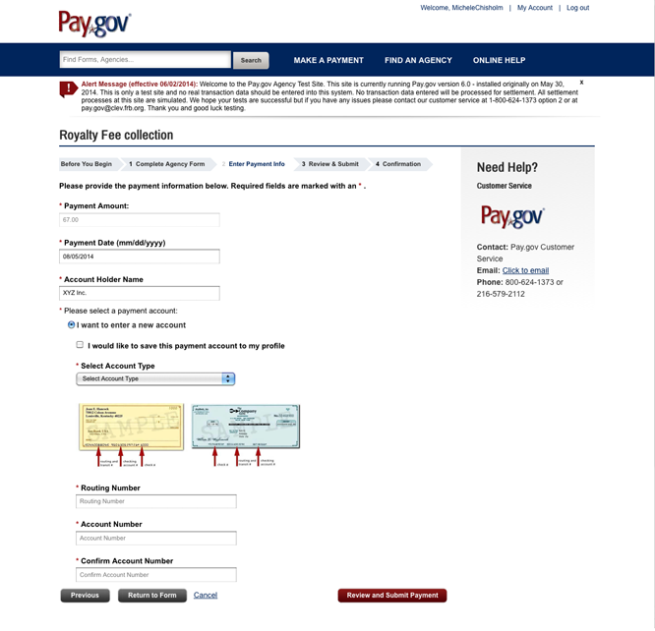
Enter Online Payment Information
Before you begin > Complete Agency Form > Enter Payment Information > Review & Submit > Confirmation > Contact
The screen will show the
total amount to be debited,
payment date,
and account name.
Select the Account Type
from the drop-down list.

Slide 17
Enter Online Payment Information
Before you begin > Complete Agency Form > Enter Payment Information > Review & Submit > Confirmation > Contact
Enter the routing number and the
account number for your bank
account from a blank check.
Click Return to Form to make
changes or Cancel to cancel
the payment.
When the information is
correct, click Review and
Submit Payment.

Slide 18
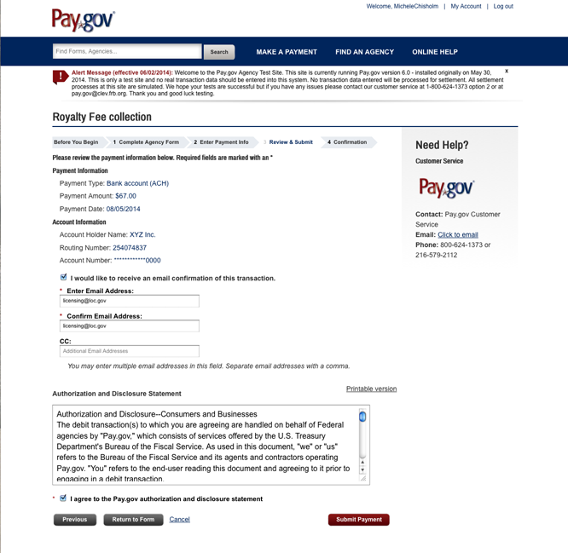
Authorize Payment
Before you begin > Complete Agency Form > Enter Payment Information > Review & Submit > Confirmation > Contact
Confirm the payment and
the account information
in the summary are
correct.

Slide 19
Authorize Payment
Before you begin > Complete Agency Form > Enter Payment Information > Review & Submit > Confirmation > Contact
Check here if you would like
to receive email confirmation.
Provide an email address to
receive a confirmation email upon
completion of this transaction.
Read the Authorization
and Disclosure Statement
If you agree, click I agree
to the Pay.gov authorization
and disclosure statement.

Slide 20
Authorize Payment
Before you begin > Complete Agency Form > Enter Payment Information > Review & Submit > Confirmation > Contact
Click Return to Form to make any
changes to the RA.
Click Previous to make any changes
to the payment information
When you have reviewed the
information, click Submit Payment.

Slide 21
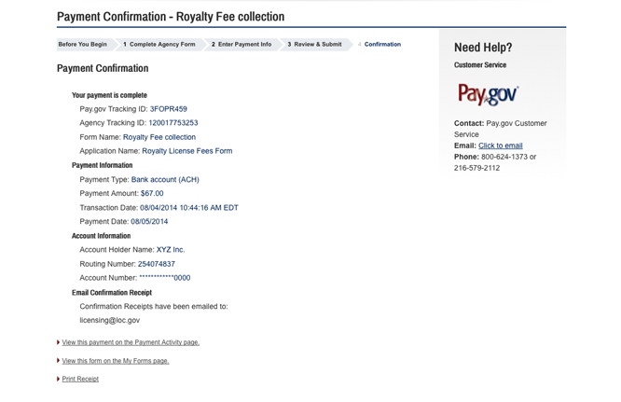
Confirm Payment
Before you begin > Complete Agency Form > Enter Payment Information > Review & Submit > Confirmation > Contact
Print a copy of the
Payment Receipt for your records.

Slide 22
Notification of the Licensing Division
Before you begin > Complete Agency Form > Enter Payment Information > Review & Submit > Confirmation > Contact
Send a copy of the Cable, Satellite, or DART Pay Royalties Form and the Payment Receipt page to the Licensing Division by email or fax.
Email: licfiscal@copyright.gov
Fax: (202) 707-0905

Slide 23
IMPORTANT
Before you begin > Complete Agency Form > Enter Payment Information > Review & Submit > Confirmation > Contact
EFTs received after the filing deadline are subject to an interest assessment. Pay.gov EFTs must be transmitted by 3 pm (Eastern Time) on one banking day to settle on the next banking day.
Failure to follow these instructions may result in return of fees to the remitter’s account.
The U.S. Copyright Office, Library of Congress, is an agency of the United States government and is exempt from backup withholding. Taxpayer identification number: 53-6002532.

Slide 24
Contact Us
Before you begin > Complete Agency Form > Enter Payment Information > Review & Submit > Confirmation > Contact
For more information about payments via electronic transfer, contact the Licensing Division at:
  Library of Congress
  Copyright Office-LD
  101 Independence Avenue SE
  Washington, DC 20557-6400
Telephone: (202) 707-8150 (8:30 am to 5:00 pm Eastern Time)
Email: licensing@copyright.gov
Internet: www.copyright.gov/licensing
Fax: (202) 707-0905

